Slide 1
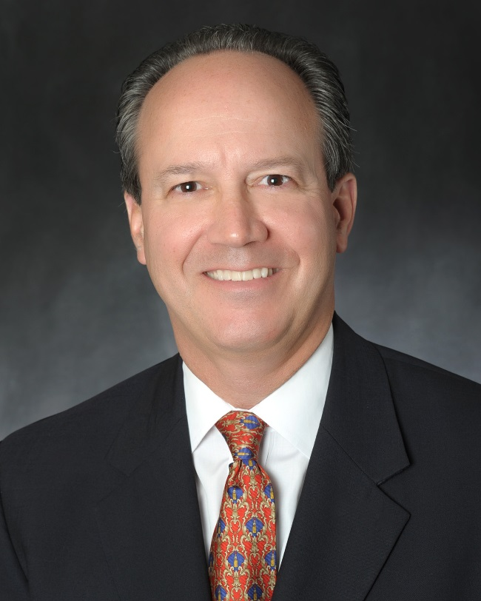
Insights to Inform Future Planning
David DuBois, CMP, CAE, FASAE, CTA
President & CEO
IAEE

Slide 2
Topics for Today
The Road to Recovery
Exhibitions – a Changing Business Model
Boosting Data and Analytic Capabilities
Meaningful Connections

Slide 3
Impact and Recovery Outlook
Notes:
Let’s turn our attention to what we are seeing in terms of impact and recovery.
Dr. Shaw, CEIR’s economist, has been creating scenarios for recovery and it looks like as usual he is right on with his forecast.
NEXT SLIDE: His scenarios were based on consumer sentiment, downward falling cases of COVID and the vaccine roll out. And these 2 elements would…..

Slide 4
The Recovery Falling Cases Vaccines Countries Opening
Notes:
Given what is known now, CEIR created a scenario analysis for recovery:
Worst Case: the Delta variant persists, and/or a new severe and highly contagious variant emerges in 2022. If so, the Total Index is forecast to drop about 71% in 2021 relative to the 2019 performance, a small improvement compared to a decline of 78.5% in 2020. In this scenario, the exhibition industry will not fully recover until 2024. The probability for the worst case scenario is 30%
Best Case: rising Delta variant infections will promote vaccination requirements for corporate and government employees. Furthermore, more service industries such as restaurants, theaters and sporting venues will require patrons to show proof of vaccinations or negative COVID-19 tests. In this case, because of rapidly rising vaccination rates and declining new cases, the exhibition industry will fully recover by mid-2022, with the Total Index surpassing 2019 by 1.5%. The probability for this scenario is 10%
The base case is the scenario CEIR forecasts will most likely happen. The cancellation rate declines further, dropping to 35% in Q3 and 5% in Q4. By 2023, the impact of COVID-19 diminishes. By 2023, exhibition performance by sector again will be determined by long-term trends, cyclical macroeconomic conditions and sector specific factors. In 2023, the industry fully recovers with the Total Index exceeding the pre-pandemic level by 2.5%. The probability for this case is 60%.

Slide 5
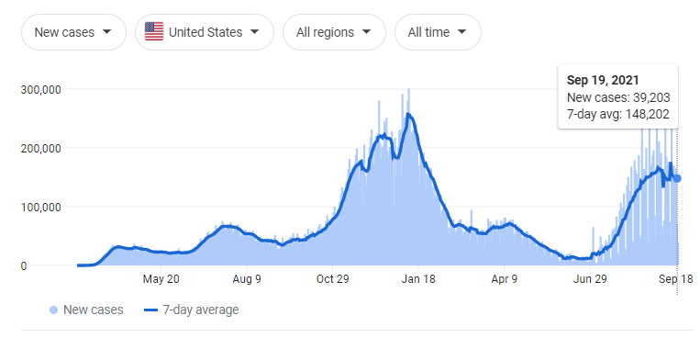

Slide 6
Understand Your Market Position

Slide 7
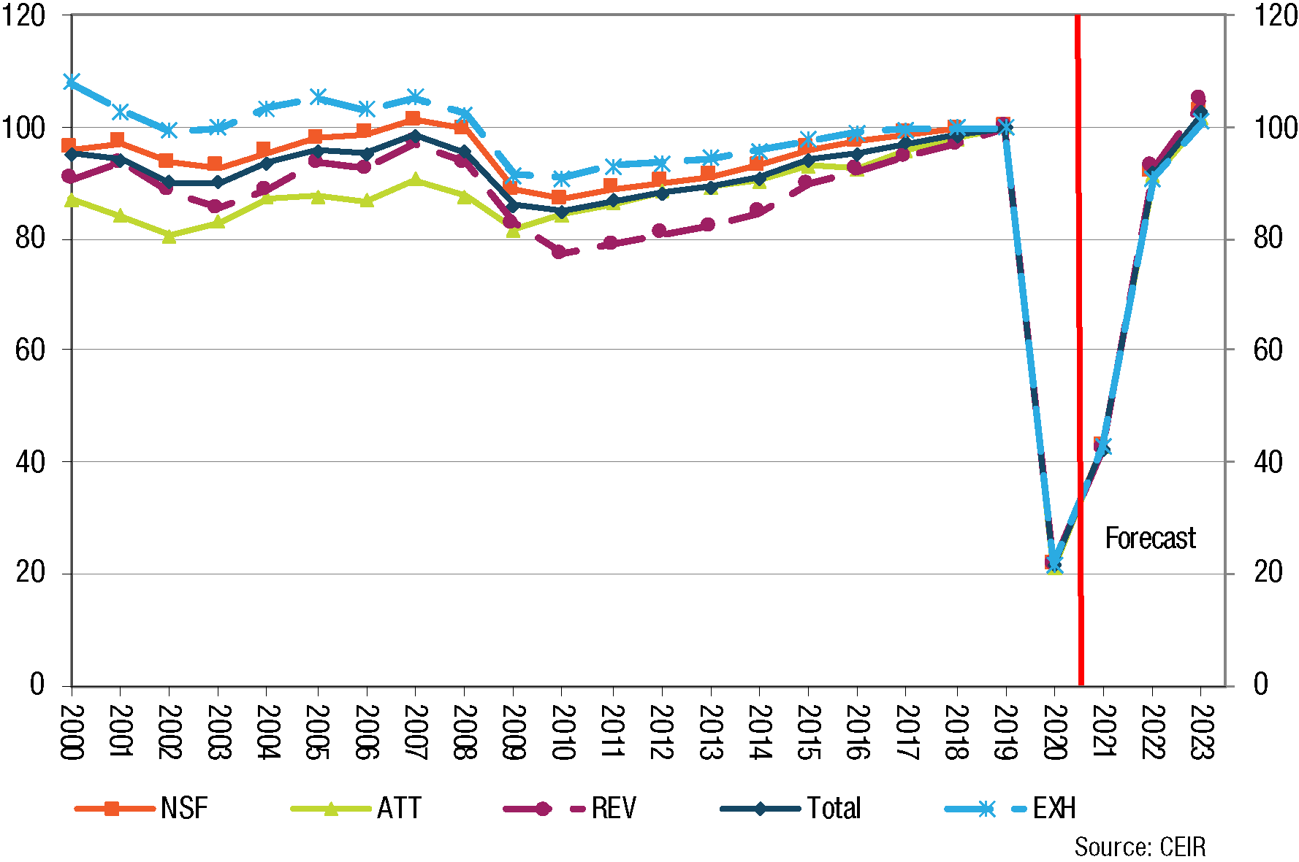
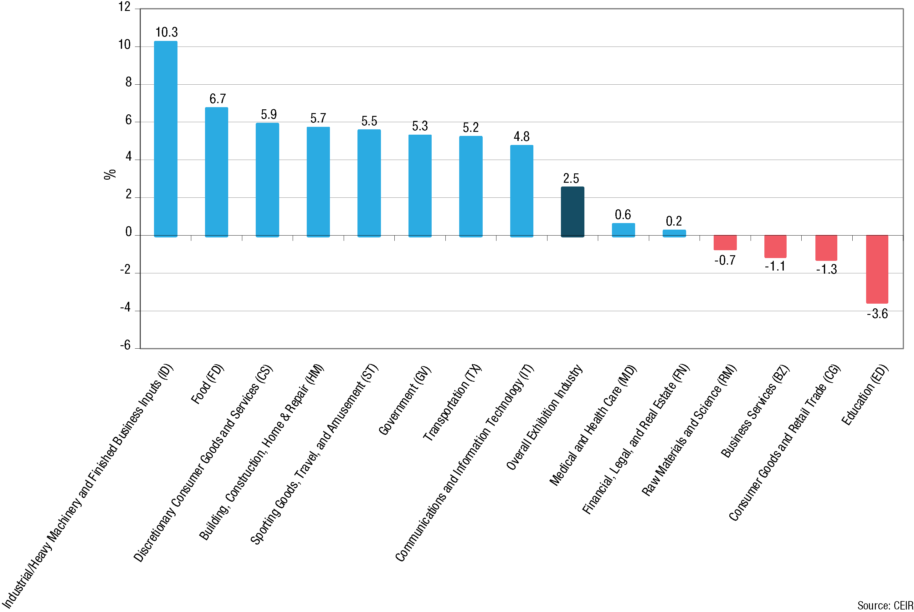
Exhibitions Industry – Recovery
CEIR Index for Overall Industry, 2000-2023, 2019=100
CEIR Total Index by Sector, 2023, Percent Change from 2019

Slide 8
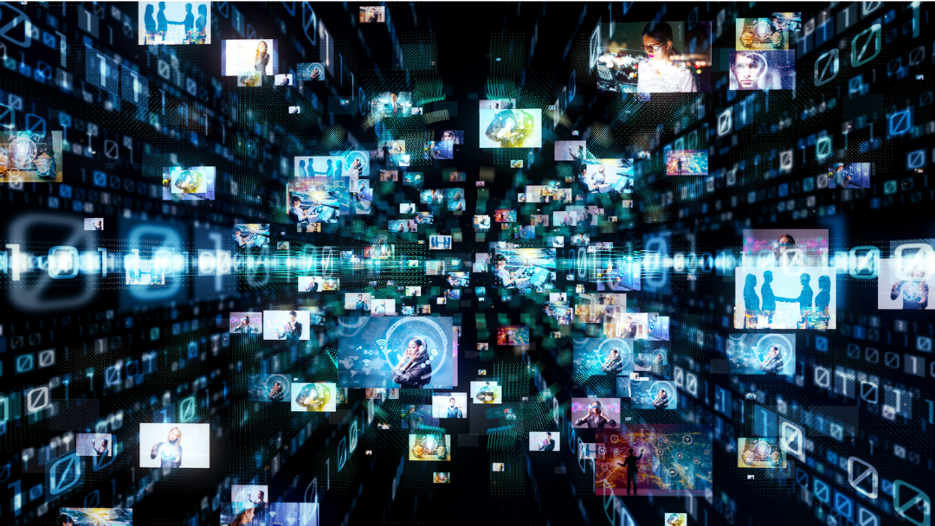
The Decision To Cancel, Go Fully Digital, Go Hybrid, Hold Physical Exhibition…

Slide 9
Cancellations Increased
Actions Taken Relating to Scheduled 2021 US B2B Exhibitions Organized or Managed
Notes:
May 2021 – 50% gross revenue loss due to cancellations and postponements on a per organizer basis

Slide 10
Hybrid Fatigue
Notes:
Digital receding among postponed events

Slide 11
Real GDP vs. CEIR Total Index, 2020 Q1- 2021 Q2, % Change from 2019

Slide 12
2021 Q2 CEIR Metrics for the Overall Exhibition Industry Excluding Cancellations, % Change from 2019 Q2

Slide 14
CEIR OMNICHANNEL MARKETING STUDY DURING COVID-19
Channels Used, Exhibitor Perceptions of Effectiveness

Slide 15
CEIR OmniChannel Marketing Study
Image of B2B exhibitions in an evolving marketplace
Channels used during pandemic
Plans to return to B2B exhibitions
Use of other channels in the event lifecycle
Sample from 20 U.S.-based 2019 B2B exhibitions with NSF of at least 45,000 of NSF or larger, as well as sample from Exhibitracs for exhibitor sample
Fielded in July to early August 2021
Valid completes:
Attendees =1,799
Exhibitors = 316

Slide 16
Channels Used During COVID-19
ATTENDEES
EXHIBITORS

Slide 17
Perceived effectiveness of channels is adequate, not a wow for supporting most urgent marketing objectives.
MOST POPULAR CURRENT
MARKETING OBJECTIVES
EFFECTIVENESS IN HELPING ACHIEVE THEM

Slide 18
Same for supporting most urgent sales objectives, does the job but not a wow.
MOST POPULAR CURRENT
SALES OBJECTIVES
EFFECTIVENESS IN HELPING ACHIEVE THEM

Slide 19
CEIR OMNICHANNEL MARKETING STUDY POST COVID OUTLOOK
Will they come back, when, and for what? Uncovering opportunities.

Slide 20
Yes exhibitors will!
Whether Exhibited in 2021 or Have Plans through 2022
H1 2021
26%
H2 2021
74%
H1 2022
58%
H2 2022
46%
No plans
6%
H1 2021
H2 2021 THRU 2022
42%
26%
Use of Hybrid Options to Participate - both in-person and online

Slide 21
So will attendees, though more slowly.
Whether Attended in 2021 or Have Plans through 2022
H1 2021
12%
H2 2021
50%
H1 2022
49%
H2 2022
33%
None
14%
H1 2021
H2 2021 THRU 2022
37% say ability to interact online will prompt a decrease in attendance at exhibitions and conventions; while 22% say it will prompt an increase.
25%
31%
Use of Hybrid Options to Participate - both in-person and online

Slide 22
For majority, importance of reasons for attending will persist or grow in the next two years.
Among attendees that have attended in 2021 or plan to attend exhibitions through 2022 and rated a reason important (5, 6 or 7)

Slide 23
Same is true for those seeking F2F engagement with exhibitors at each stage of the purchase process.
Among attendees that have attended in 2021 or plan to attend exhibitions through 2022 and rated a given stage important/extremely important

Slide 24
Along the edges there is a group, 22% to 8%, that will use other channels for purposes where the role of exhibitions will be less.
Reasons for attending
Engaging F2F with exhibitors
Other in-person, F2F B2B events
Engaging F2F with exhibitors
51%
50%
47%
49%
Virtual Only B2B Channels
Other in-person, F2F B2B events
Notes:
22% say 1+ reasons will be less important and 8%, F2F engagement with exhibitors

Slide 25
For exhibitors, the value of B2B exhibitions in helping achieve marketing and sales objectives will persist or expand in the next two years.
Helping Meet High Priority Marketing Objectives
Helping Meet High Priority Sales Objectives
Among exhibitors that have exhibited in 2021 or have exhibit plans through 2022 and rated use of exhibitions as very high/high value in supporting a given objective

Slide 26
Same is true for those seeking F2F engagement with attendees at each stage of the purchase process.
Among exhibitors that have exhibited in 2021 or have exhibit plans through 2022 and rated use of exhibitions as Extremely Important/Important for a given stage

Slide 27
Again, on the edges, a minority will use other channels to fulfill roles that will be reduced for B2B exhibitions.
Identified 1+ Areas Where Role of Exhibitions Will Be Reduced
Marketing objectives
16%
Sales objectives
15%
Stages of Purchase Process
20%
Notes:
NUMBERS ARE SO SMALL WILL NOT CHART, THOUGH MIGHT SAY
Effectiveness of alternative channels to-date are similar to ratings registered for current channel mix, they’re ‘effective’ though not highly effective, effective scores – 40% to 50% for digital b2b online. Email is a solid performer, 48% effective, as is digital b2b online marketing, 58% effective. Other in-person, weaker, 32%, same for virtual/online B2B events, 34%

Slide 28
Exhibitors actively use other channels to promote participation, signaling omni channel marketing opportunities to mine.
Notes:
NUMBERS ARE SO SMALL WILL NOT CHART, THOUGH MIGHT SAY
Effectiveness of alternative channels to-date are similar to ratings registered for current channel mix, they’re ‘effective’ though not highly effective, effective scores – 40% to 50% for digital b2b online. Email is a solid performer, 48% effective, as is digital b2b online marketing, 58% effective. Other in-person, weaker, 32%, same for virtual/online B2B events, 34%

Slide 29
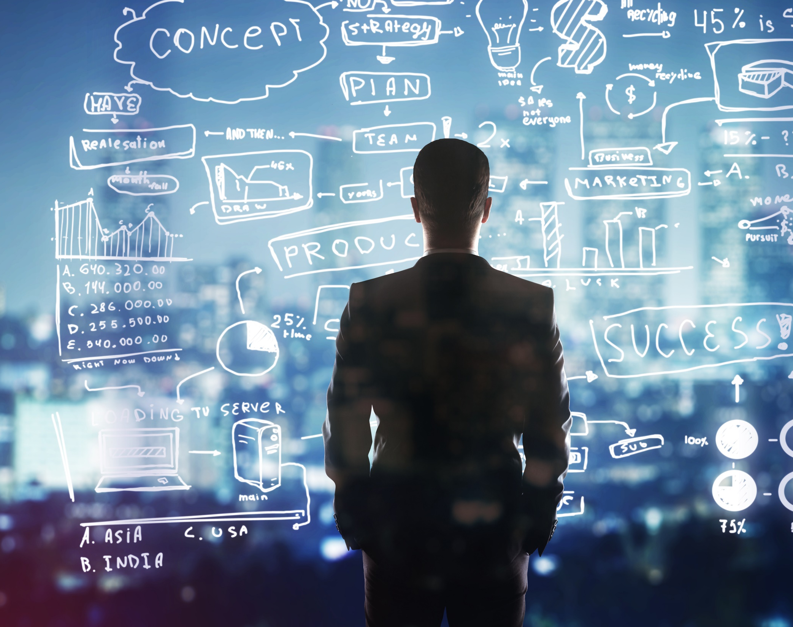
New Opportunities

Slide 30
The show is a touchpoint. Not an endpoint.

Slide 31
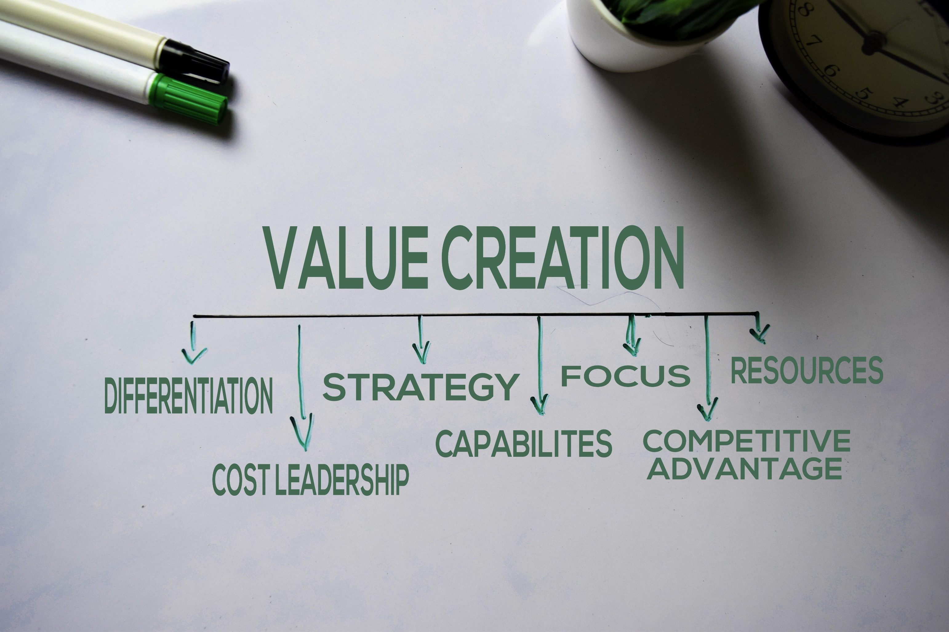

Slide 32
Create and Sustain Value Creation
Invest sufficient capital and talent in large, risky initiatives to achieve winning position
Construct a portfolio of strategic initiatives that deliver returns exceeding the cost of capital
Dynamically allocate capital and talent to the business and activities that create the most value
Generate value not only for your exhibitors and visitors, but also for employees and other stakeholders
Resist the temptation to take actions that boost short-term profits

Slide 33
Digital is here to stay
Hybrid integration of content and commerce
Digital broadcasting
Communities

Slide 34
Event Platforms
How event platforms use your data
Statement in agreements that you own the data
Strongly worded Data Privacy Agreement
CEIR releasing an RFP document with questions to ask your platform provider

Slide 35
Boosting Data and Analytic Capabilities What’s Your Organization’s Digital Strategy?
Notes:
Our World has changed – downstream effects caused by the differences in how we communicate work on a biz level is that catalyst. This is not going away. Also, the Competitive landscape has changed. Digital has made it possible. The Pandemic has brought to light the need to move faster than originally anticipated in order maintain relevance.

Slide 36
Meaningful Connections

Slide 37
Conclusions
B2B exhibitions enjoy a strong brand image
COVID-19 is the deterrent, not a negative image of the channel
Think complementary, not competitive
Seize the opportunities to:
Deepen relevance, value, engagement
Drive:
Attendee, membership, subscriber acquisition
Exhibitor/sponsorship sales
New, ancillary revenue streams

Slide 38
Insights Summary
Phased Recovery
Organizers will build year-round communities. Associations may already have.
Omnichannel – retail model
Labor challenges
Expansion beyond F2F
Integrated event approach
Physical / Digital – 2 separate events. Design for this.
It’s still about making connections
Commerce of content remains a challenge

Slide 39
Insights Summary
Exhibitors
Visitors / Attendees
Exhibitors expect detailed and understandable data that’s important to them
Fewer exhibitions
Domestic events
Local reps
Fewer exhibitions
Less attendance overall for many. Buyers there are committed.

Slide 40
Thank you ddubois@iaee.com

